Slide 1
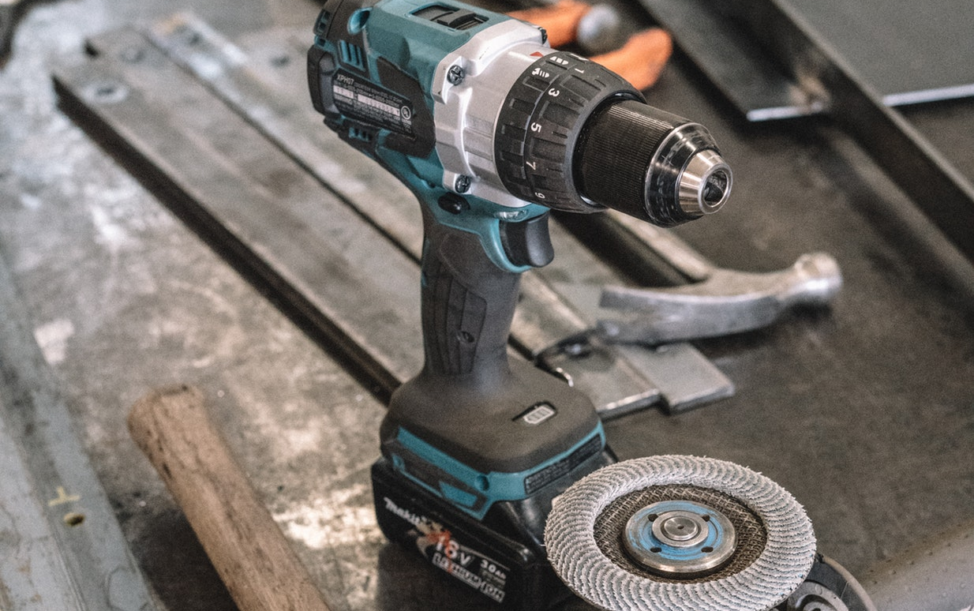
Client Side Development Tools
Server Side Development / Web Programming
These tools are only important if you are building client side web apps
Why?
??????????

Slide 2
The 2 tools you will need
Server Side Development / Web Programming
Transpiler
Bundler
Transpiler
Bundler
Converts Modern JavaScript into JavaScript all browsers can understand
Compiles code for easy distribution. Compiles modules into one file.

Slide 3
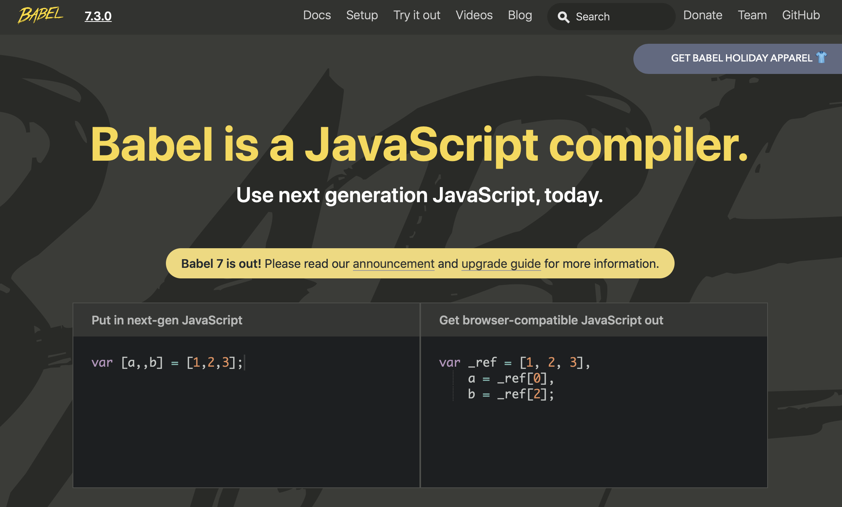
Babel
Server Side Development / Web Programming
Transpiler
Translator + Compiler = Transpiler
It takes modern JavaScript and converts it to JavaScript all browsers can understand
Babel is one of the most popular
https://babeljs.io

Slide 4
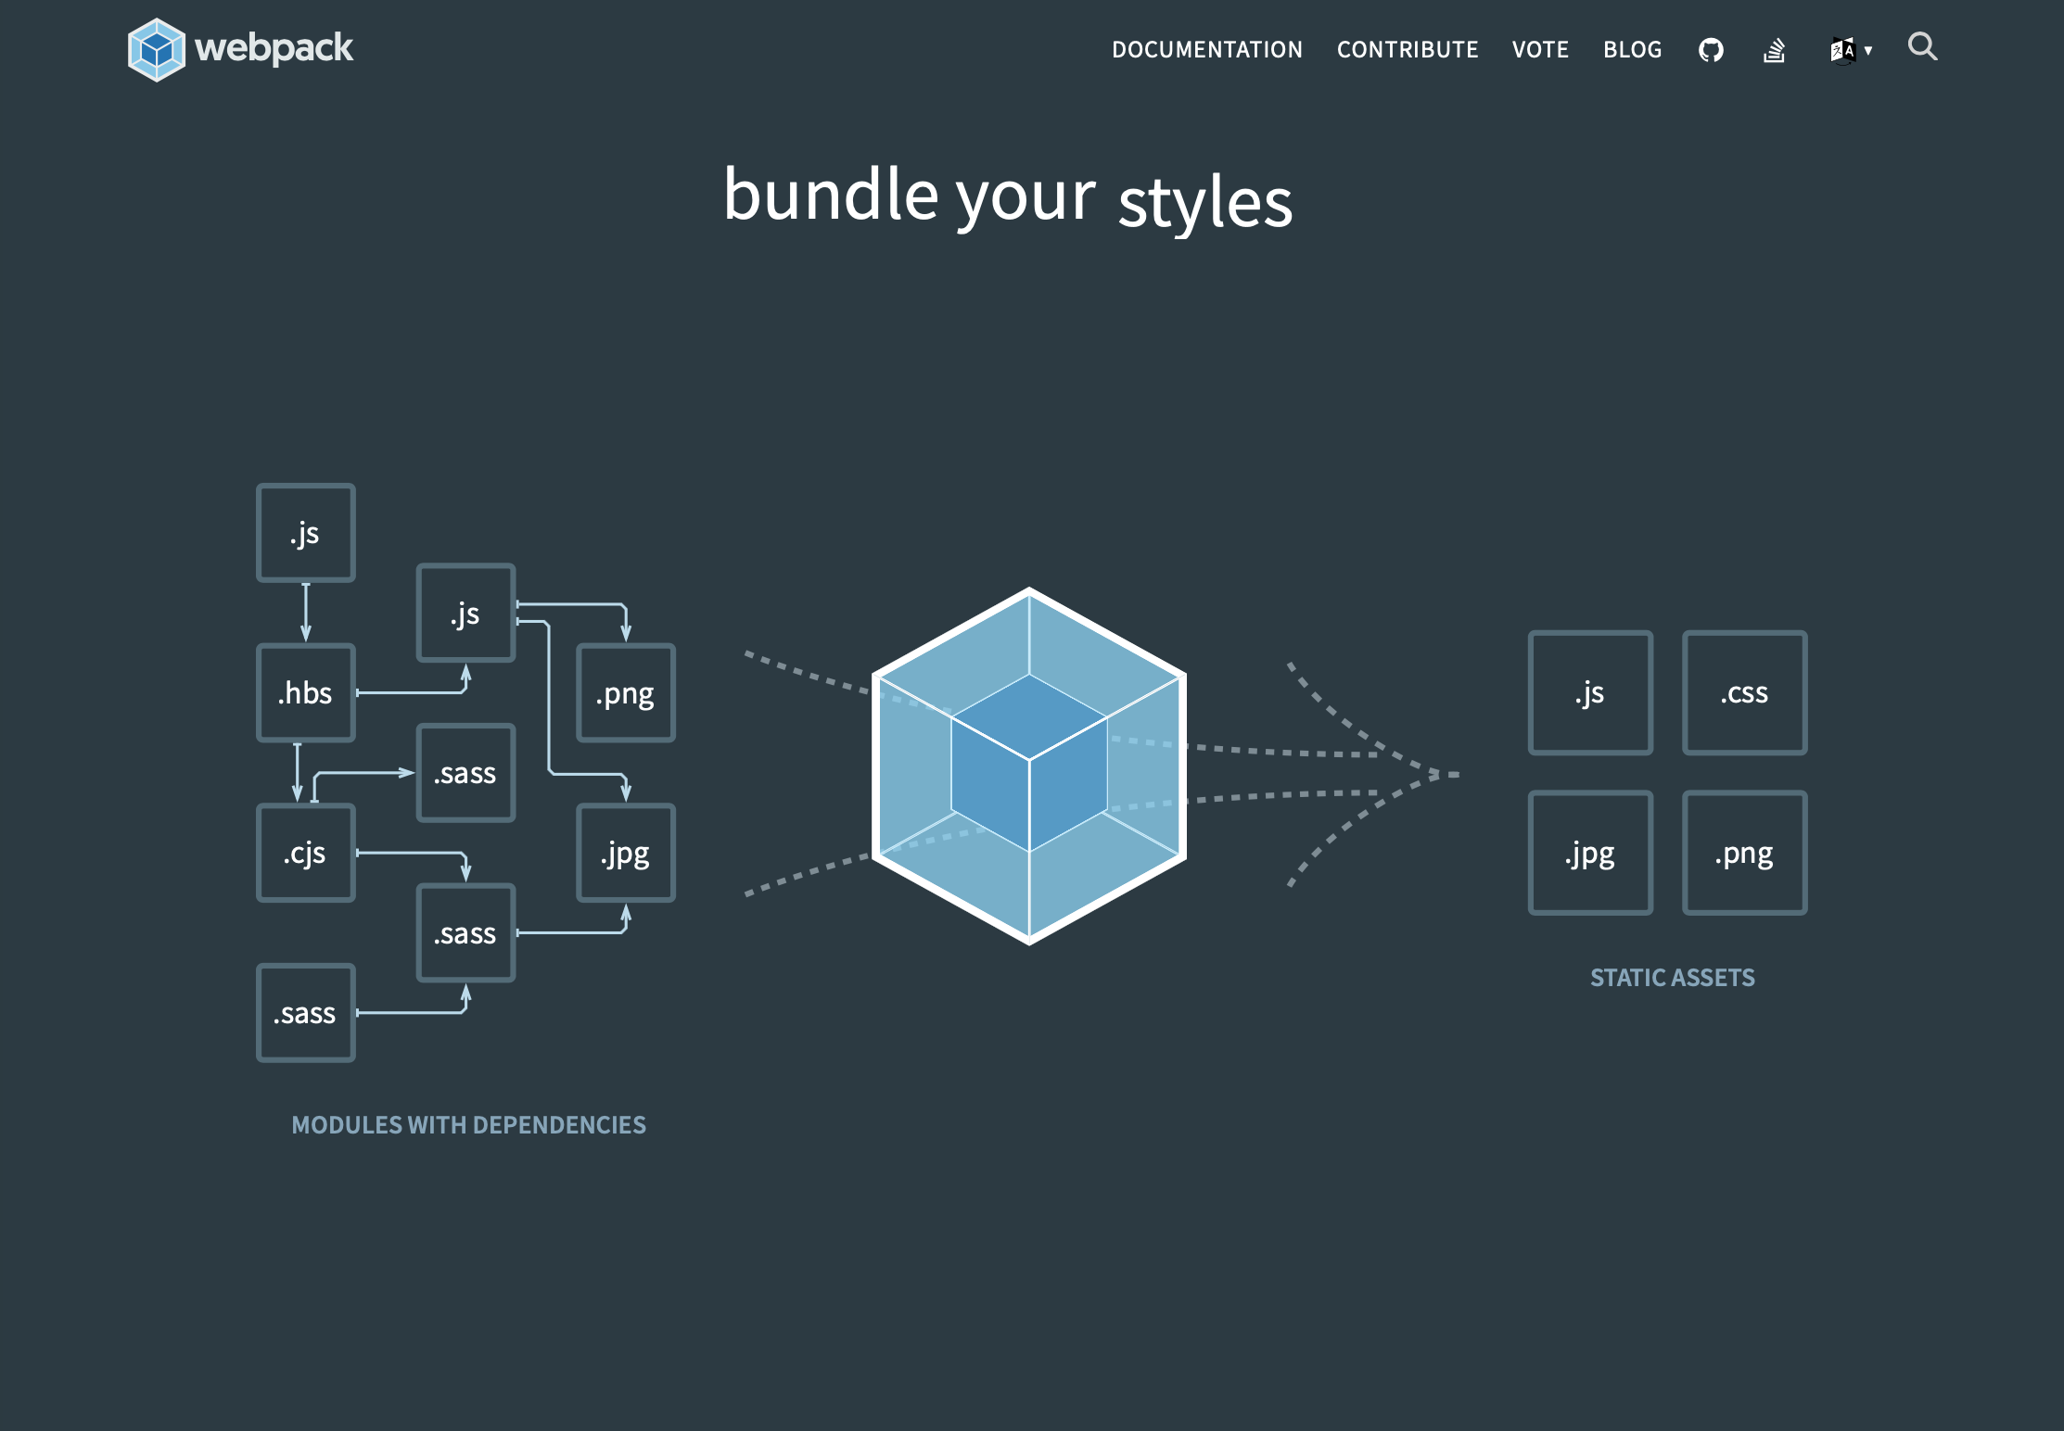
Webpack
Server Side Development / Web Programming
Bundler
Combines all our JavaScript Modules into one file
Webpack is the most popular
It Minifies code = Removes white space
It Uglifies code = shortens names
https://webpack.js.org

